Slide 1
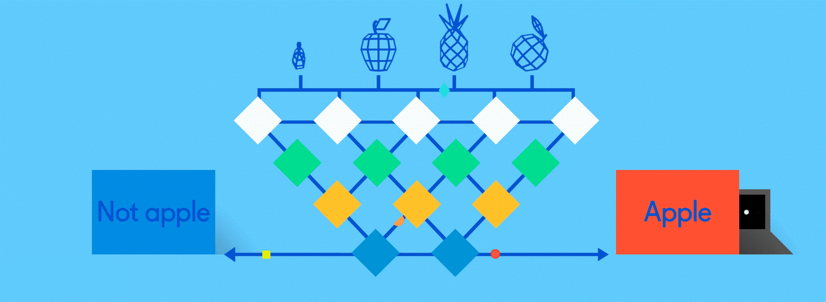
Neural Networks for Machine Learning History and Concepts

Slide 2
Overview
The neural network computing model has a long history
Evolved over 75 years to solve its inherent problems, becoming the dominant model for machine learning in the 2010s
Neural network models often give better results than earlier ML models
But they are expensive to train and apply
The field is still evolving rapidly

Slide 3
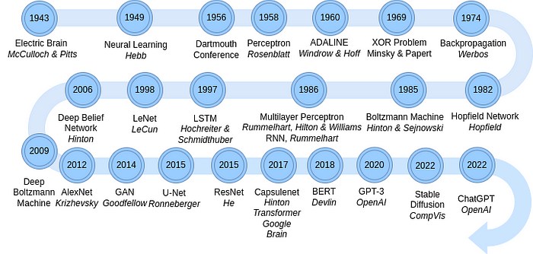
Neural Network Timeline
Source: Pumalin

Slide 4
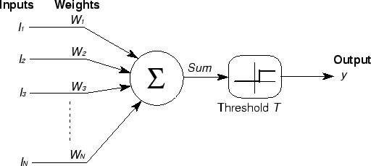
McCulloch & Pitts
First mathematical model of biological neurons, 1943
All Boolean operations can be implemented by these neuron-like nodes
Competitor to Von Neumann model for general purpose computing device
Origin of automata theory

Slide 5
Artificial neural network
Model still used today!
Set of nodes with inputs and outputs
Node performs computation via an activation function
Weighted connections between nodes
Connectivity gives network architecture
NN computations depend on connections, weights, and activation function
Notes:
Set of nodes
Node have inputs and outputs
Nodes performs computation via its activation function
Weighted connections between nodes
Connectivity gives structure/architecture of net
What can be computed by a NN determined by the connections and their weights
Simplified version of networks of neurons in animal nerve systems

Slide 6
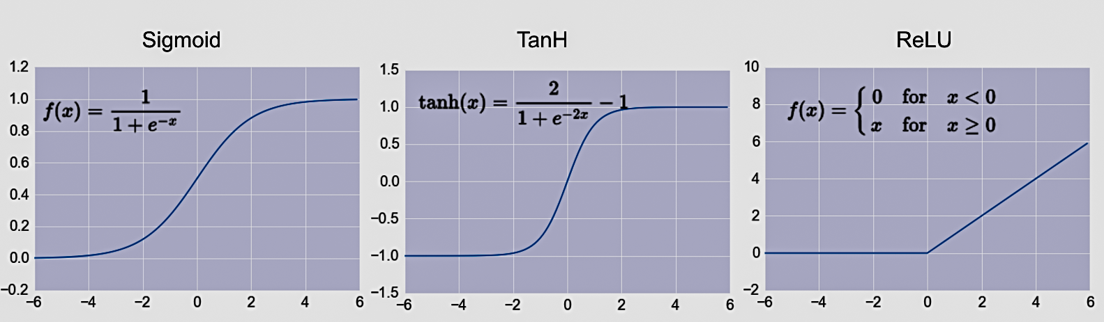
Common Activation Functions
Define the output of a node given an input
Very simple functions!
Choice of activation function depends on problem and available computational power
Comprehensive list of activation functions
In practice

Slide 7
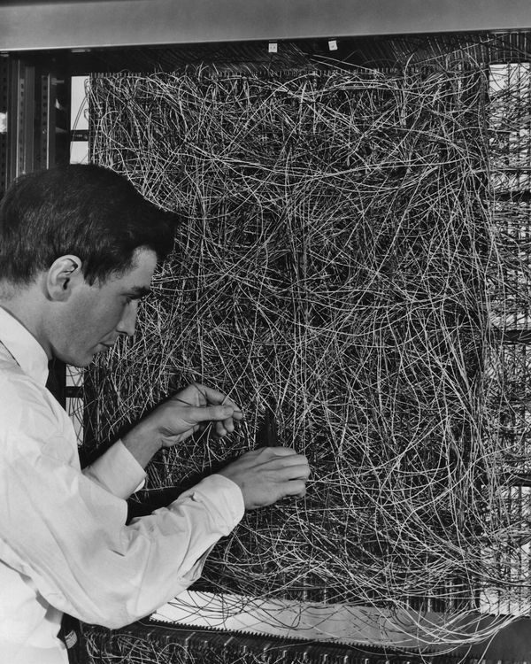
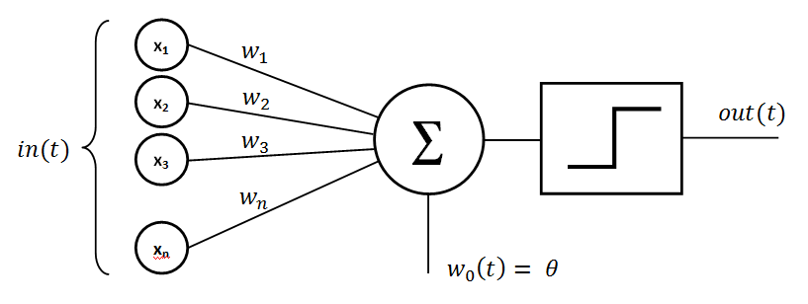
Rosenblatt’s perceptron (1958-60)
Single layer network of nodes
Real valued weights +/-
Supervised learning using a simple learning rule
Essentially a linear classifier
Widrow & Hoff (1960-62) added better learning rule using gradient descent
Mark 1 perceptron computer, Cornell Aeronautical Lab, 1960

Slide 8
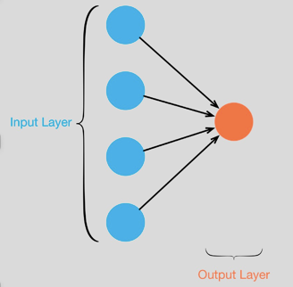
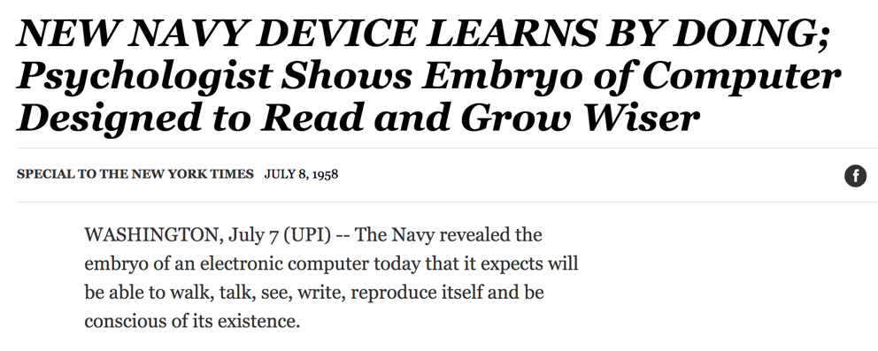
Single Layer Perceptron
See the full 1958 NYT article above here
Rosenblatt: it can learn to compute functions by learning weights on inputs from examples

Slide 9
Not with a perceptron ☹
Consider Boolean operators (and, or, xor) with four possible inputs: 00 01 10 11
Training examples are not linearly separable for one case: sum=1 iff x1 xor x2

Slide 10
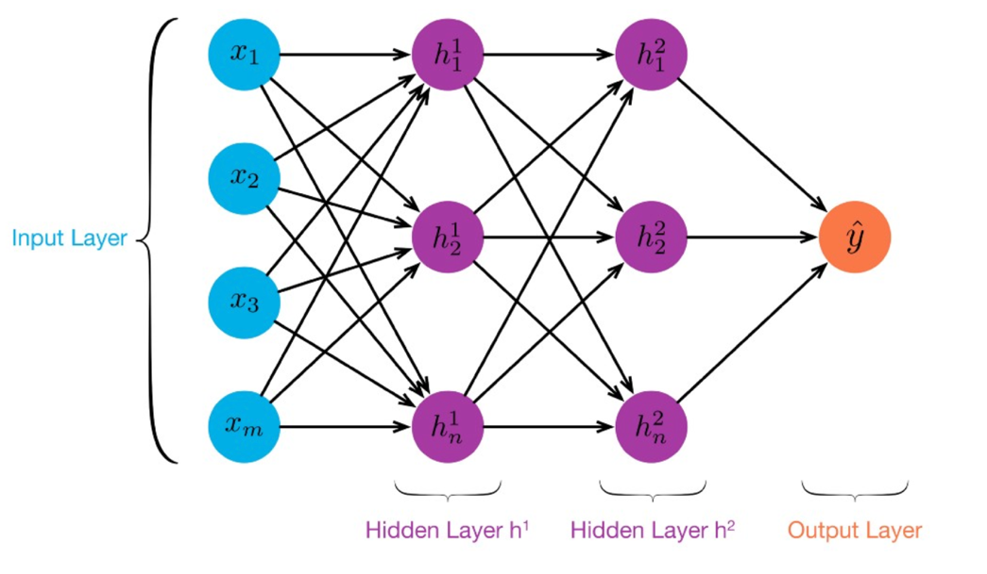
MLP: Multilayer Perceptron
≥ 1 “hidden layers” between inputs & output
Can compute non-linear functions (why?)
Training: adjust weights slightly to reduce error between output y and target value t; repeat
Introduced in 1980s, still used today

Slide 11
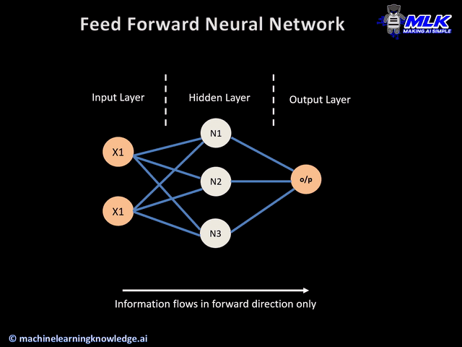

Slide 12


Slide 13
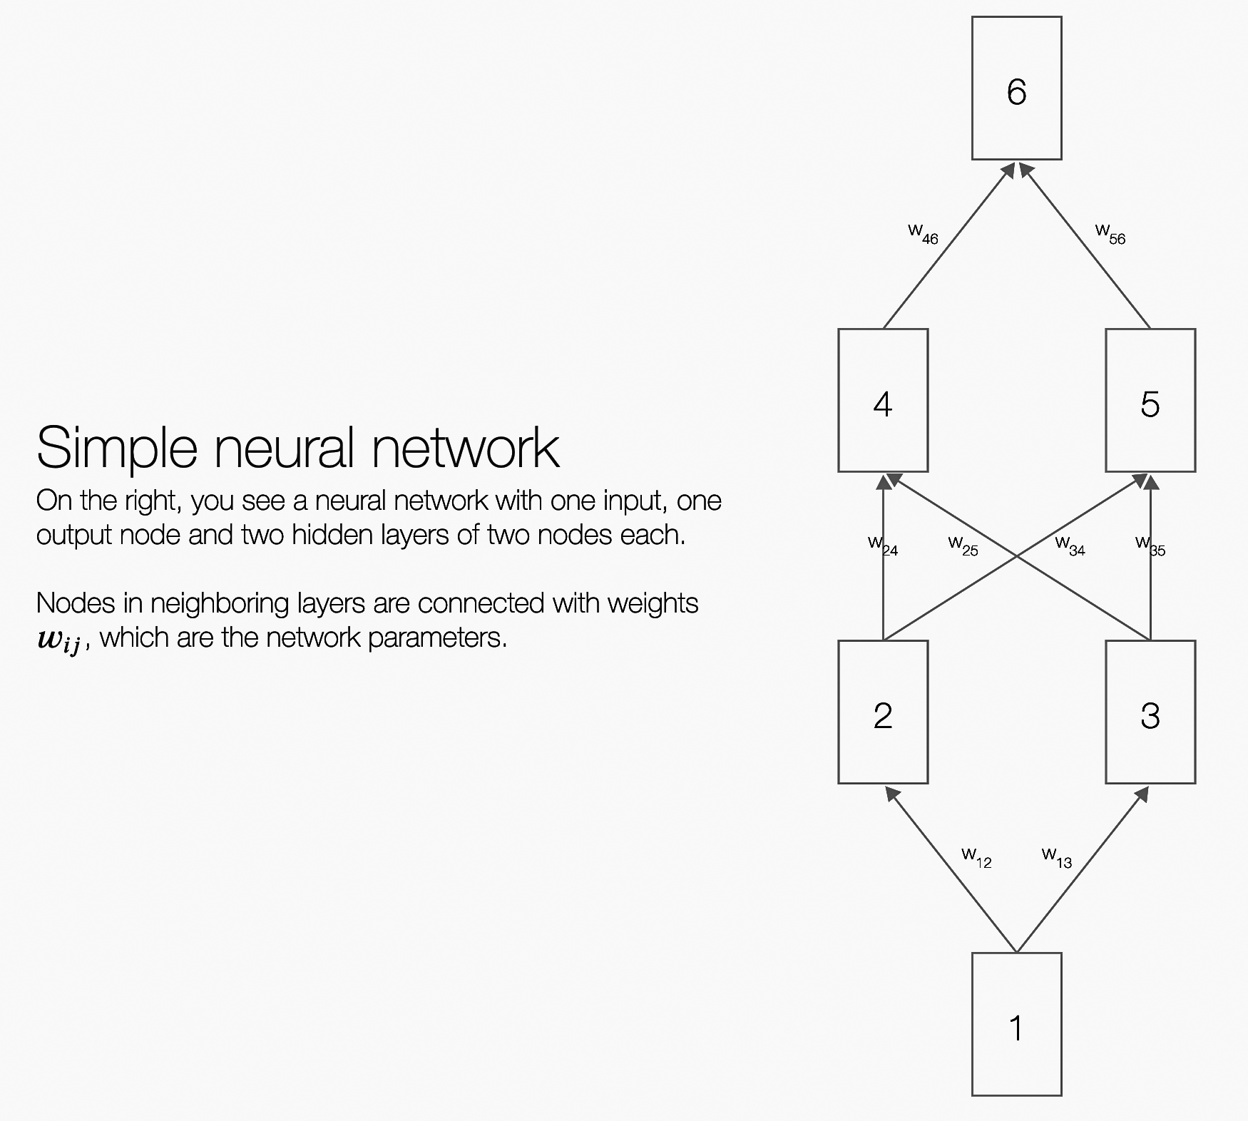
Backpropagation Explained
Click on image (or here) for a simple interactive demo in your browser of how backpropagation updates weights in a neural network to reduce errors when processing training data

Slide 14
But problems remained …
It’s often the case that solving a problem just reveals a new one that needs solving
For a large MLPs, backpropagation takes forever to converge!
Two issues:
Not enough compute power to train the model
Not enough labeled data to train the neural net
SVMs may be better, since they converge to global optimum in O(n^2)

Slide 15
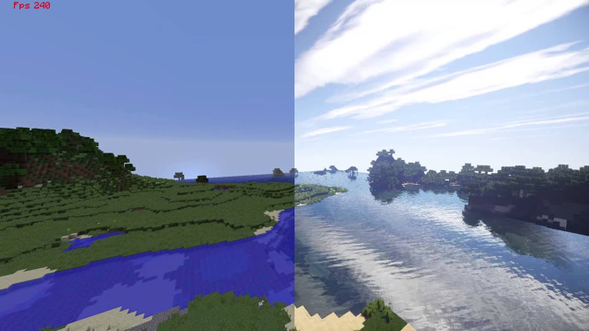
GPUs solve compute power problem
GPUs (Graphical Processing Units) became popular in the 1990s to handle computing needed for better computer graphics
GPUs are SIMD (single instruction, multiple data) processors
Cheap, fast, and easy to program
GPUs can do matrix multiplication and other matrix computations very fast

Slide 16
New problems are surfaced
2010s was a decade of domain applications
These came with new problems, e.g.,
Images are too highly dimensioned!
Variable-length problems cause gradient problems
Training data is rarely labeled
Neural nets are uninterpretable
Training complex models required days or weeks
This led to many new “deep learning” neural network models

Slide 17
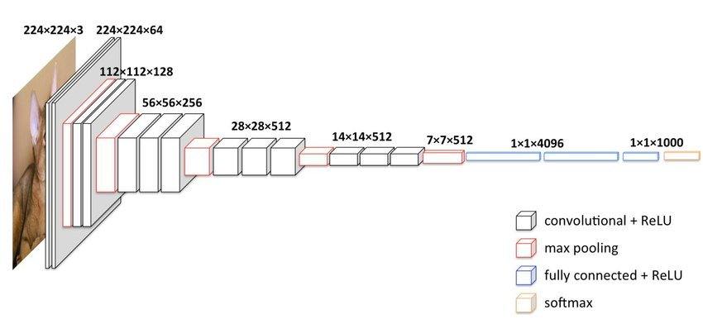
Deep Learning
Deep learning refers to models going beyond simple feed-forward multi-level perceptron
Though it was used in a ML context as early as 1986
“deep” refers to the models having many layers (e.g., 10-20) that do different things
22 layers!
The VGG16 CNN model for image processing

Slide 18
Neural Network Architectures
Current focus on large networks with different “architectures” suited for different tasks
Feedforward Neural Network
CNN: Convolutional Neural Network
RNN: Recurrent Neural Network
LSTM: Long Short Term Memory
GAN: Generative Adversarial Network
Transformers: generating output sequence from input sequence

Slide 19
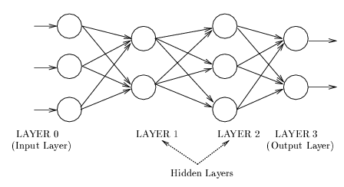
Feedforward Neural Network
Connections allowed from a node in layer i only to nodes in layer i+1, i.e., no cycles or loops
Simple, widely used architecture, provides a good baseline
Backpropagation used while training, of course
downstream nodes tend to successively abstract features from preceding layers

Slide 20
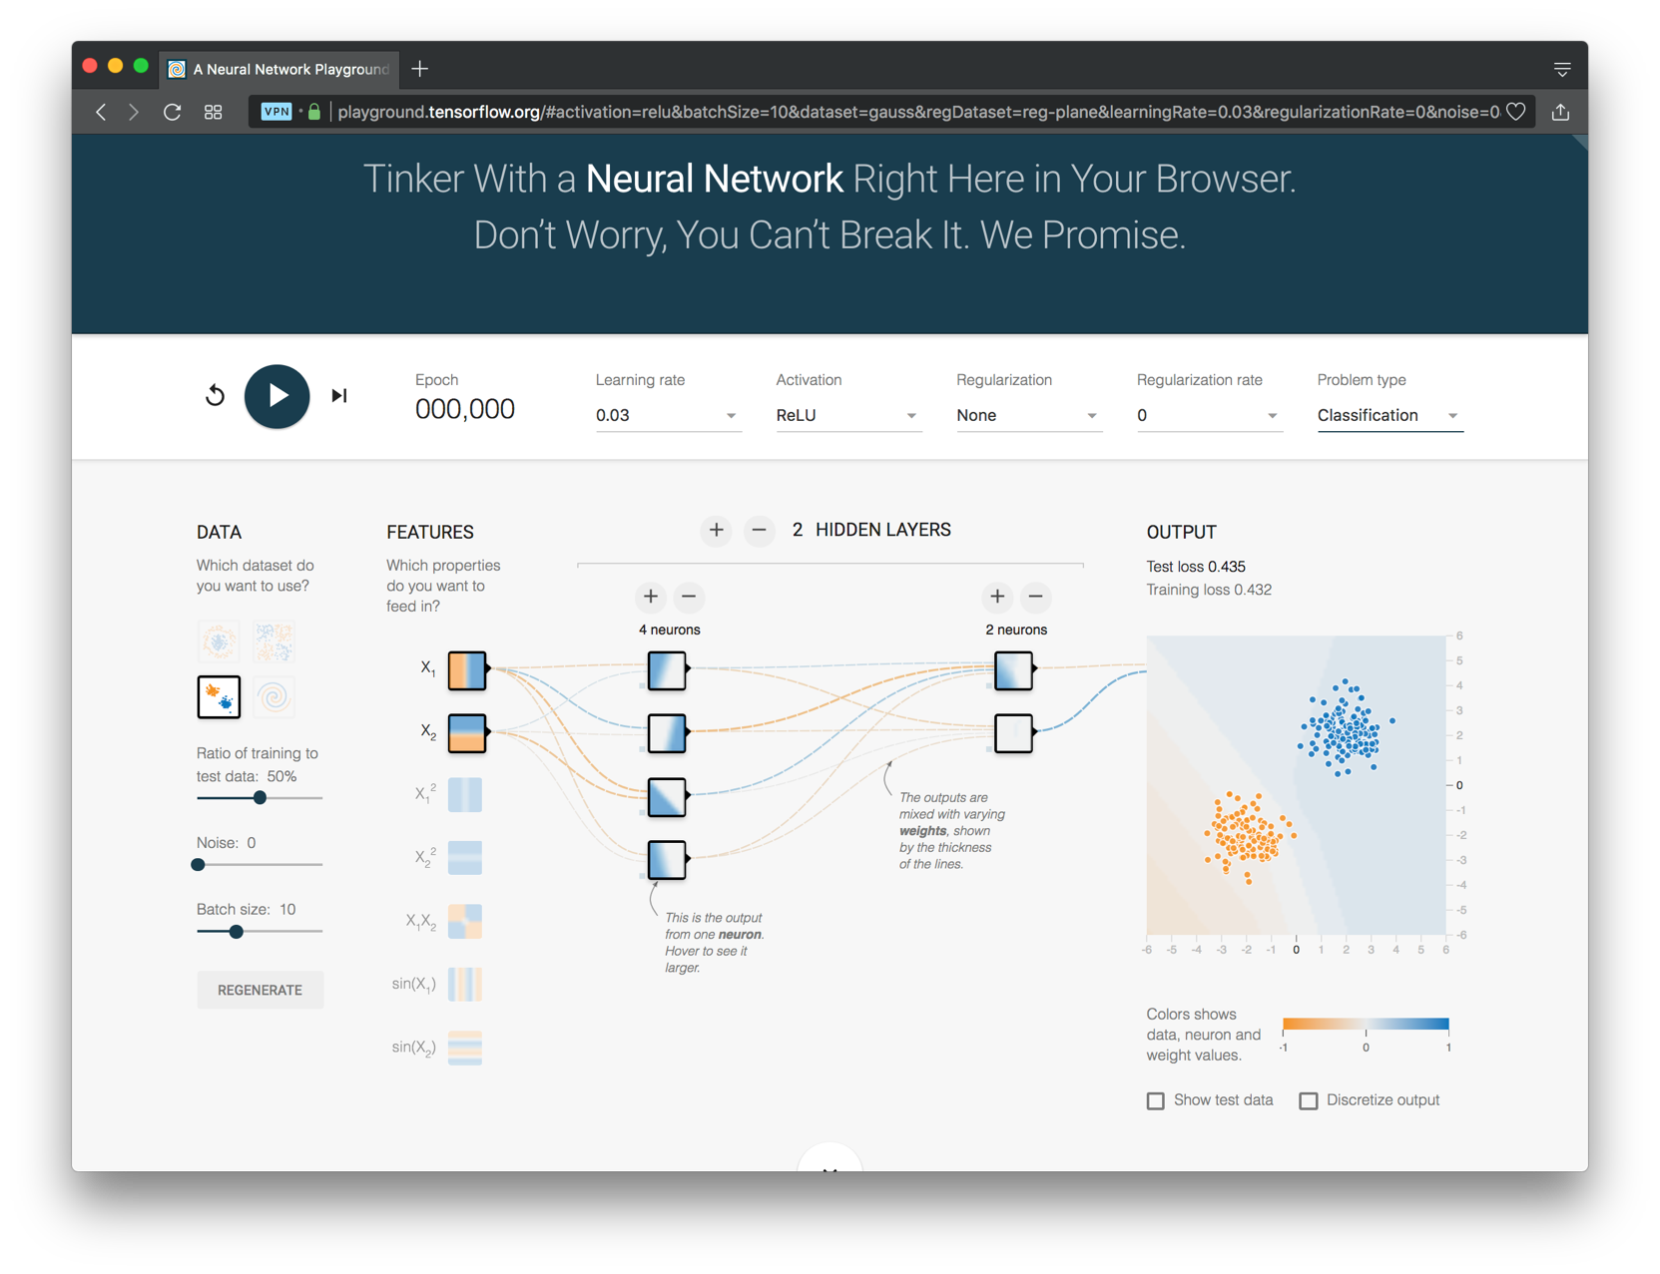
http://playground.tensorflow.org/

Slide 21
1. Select dataset
http://playground.tensorflow.org/

Slide 22
1. Select dataset
2. Choose features
http://playground.tensorflow.org/

Slide 23
1. Select dataset
2. Choose features
3. Add layers
http://playground.tensorflow.org/

Slide 24
1. Select dataset
2. Choose features
3. Add layers
4. Parameters
http://playground.tensorflow.org/

Slide 25
1. Select dataset
2. Choose features
3. Add layers
4. Parameters
5. Task
http://playground.tensorflow.org/

Slide 26
CNN: Convolutional Neural Network
Good for 2D image processing: classification, object recognition, automobile lane tracking, etc.
Successive convolution layers learn higher-level features
Classic demo: learn to recognize hand-written digits from MNIST data with 70K examples
In-Depth

Slide 27
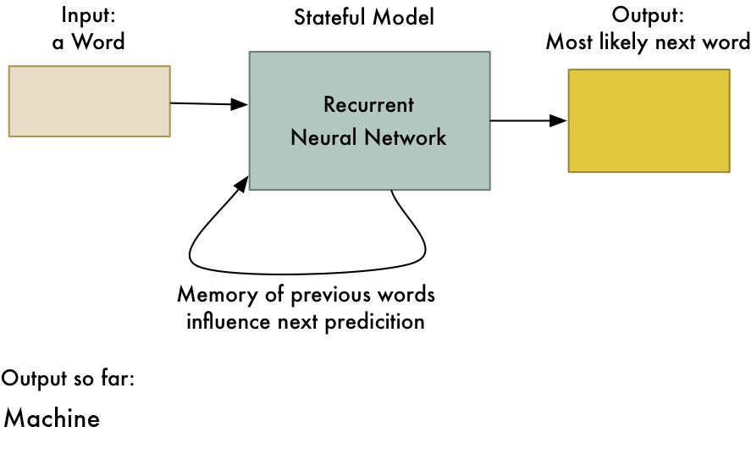
RNN: Recurrent Neural Networks
Good for learning over sequences of data, e.g., a sentence of words
LSTM: (Long Short Term Memory) a popular architecture that remembers and uses previous N inputs
BI-LSTM: knows previous and upcoming inputs
Attention: recent idea that learns long-range dependencies between inputs
from Adam Geitgey

Slide 28
GAN: Generative Adversarial Network
System of two neural networks competing against each other in a zero-sum game framework
Provides a kind of unsupervised learning that improves the network
Introduced by Ian Goodfellow et al. in 2014
Can learn to draw samples from a model that is similar to data that we give them

Slide 29
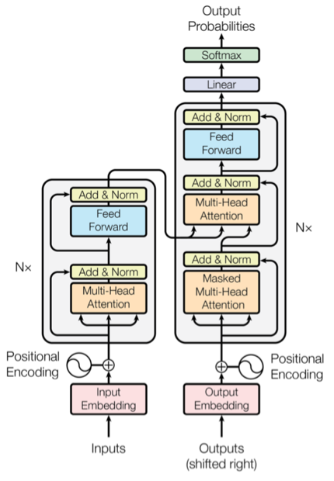
Transformer
Introduced in 2017 & has largely replaced RNNs
Used primarily for natural language & vision processing tasks
NLP applications ”transform” an input text into an output text
E.g., translation, summarization, question answering
Uses encoder-decoder architecture with attention
Popular pre-trainted models available, e.g. BERT and GPT

Slide 30
Deep Learning Frameworks (1)
Popular open-source deep learning frame-works use Python at top-level; C++ in backend
TensorFlow (via Google)
Keras (Open Source, now TensorFlow’s I/F)
PyTorch (via Facebook)
MxNet (Apache)
Caffe (Berkeley)
TensorFlow and PyTorch now dominate; both make it easy to specify a complicated network
Keras is now part of TensorFLow
Notes:
Demo: MNIST CNN
Demo: RNN sentiment

Slide 31
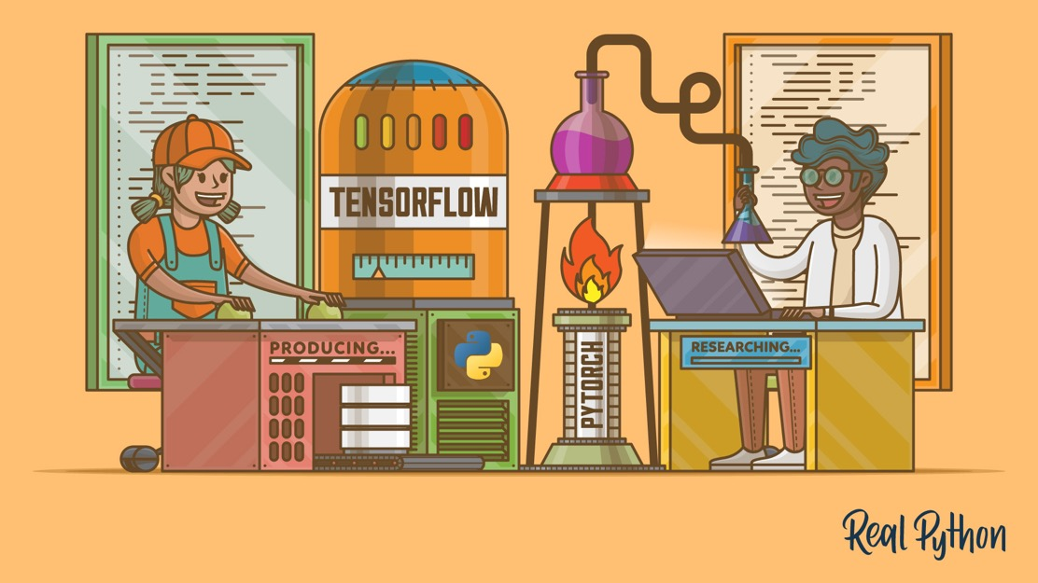
TensorFlow vs PyTorch
TensorFlow is from Google, PyTorch from Apple
Both make it each to define and use a neural network structure in Python
TensorFlow used to dominate, but now PyTorch is becoming more popular
PyTorch vs TensorFlow for Your Python Deep Learning Project

Slide 32

Keras
“Deep learning for humans”
A popular API works with TensorFlow provides good support at architecture level
Keras (v2.4 +) only supports TensorFlow
Supports CNNs and RNNs and common utility layers like dropout, batch normalization and pooling
Coding neural networks used to be harder; Keras made it easier and more accessible
Documentation: https://keras.io/

Slide 33
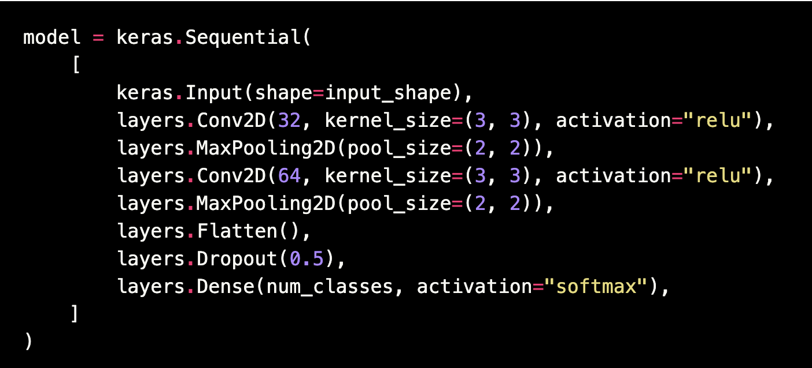
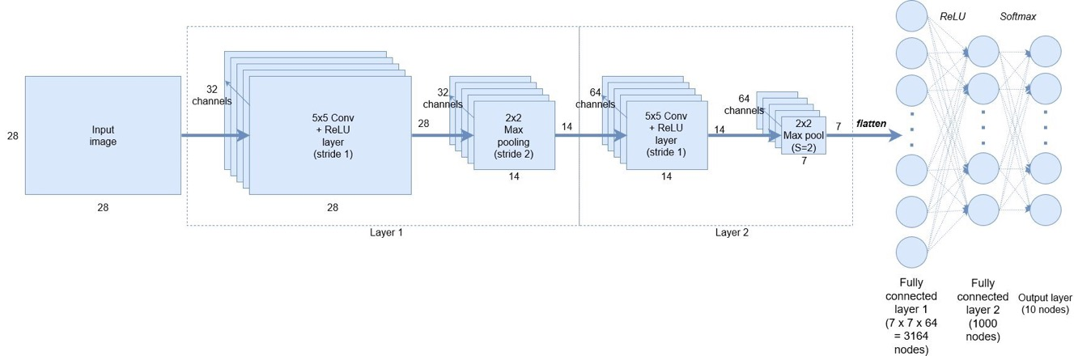
Keras: API works with TensorFlow
Example from a simple MNIST convolutional network
Notes:
Demo: MNIST CNN
Demo: RNN sentiment

Slide 34
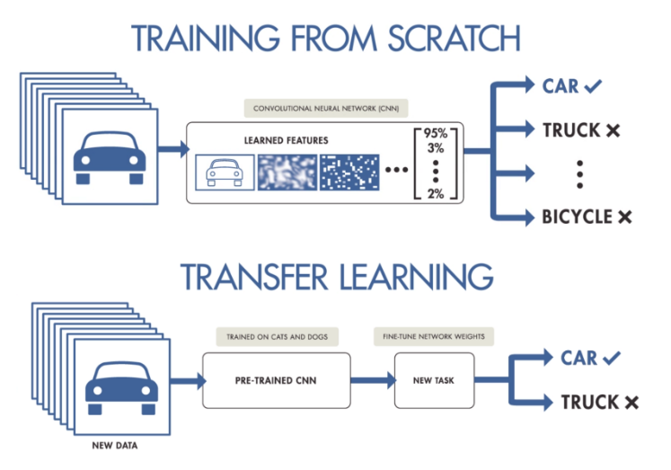
NNs Good at Transfer Learning
Neural networks effective for transfer learning
Using parts of a model trained on a task as an initial model to train on a different task
Particularly effective for image recognition and language understanding tasks

Slide 35
Good at Transfer Learning
For images, the initial stages of a model learn high-level visual features (lines, edges) from pixels
Final stages predict task-specific labels
source:http://ruder.io/transfer-learning/

Slide 36
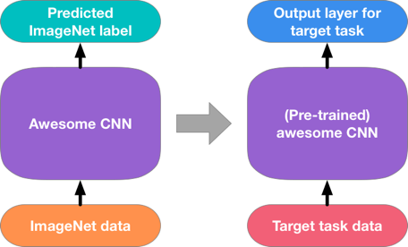
Fine Tuning a NN Model
Special kind of transfer learning
Start with a pre-trained model
Replace last output layer(s) with a new one(s)
One option: Fix all but last layer by marking as trainable:false
Retraining on new task and data very fast
Only the weights for the last layer(s) are adjusted
Example
Start: NN to classify animal pix with 100s of categories
Finetune on new task: classify pix of 10 common pets

Slide 37
Conclusions
Quick intro to neural networks & deep learning
Learn more by
Try scikit-learn’s neural network models
Explore TensorFlow with Keras / PyTorch
Work through examples
and then try your own project idea

